Slide 1

Funny Gorilla 诙猩猩-IT培训
Your success is our success
Software Testing Methodology

Slide 2
Testing Objectives

Slide 3
Strengthening product quality
Improving test coverage
Reducing manual testing
Minimizing maintenance and increasing portability of tests
Enhancing the stability of a software product
Reducing quality costs

Slide 4
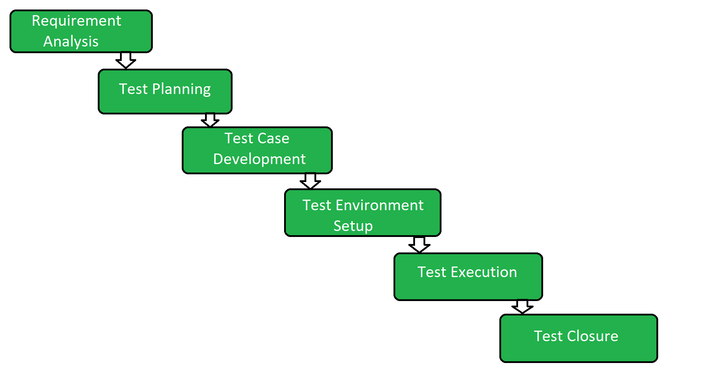

Slide 5
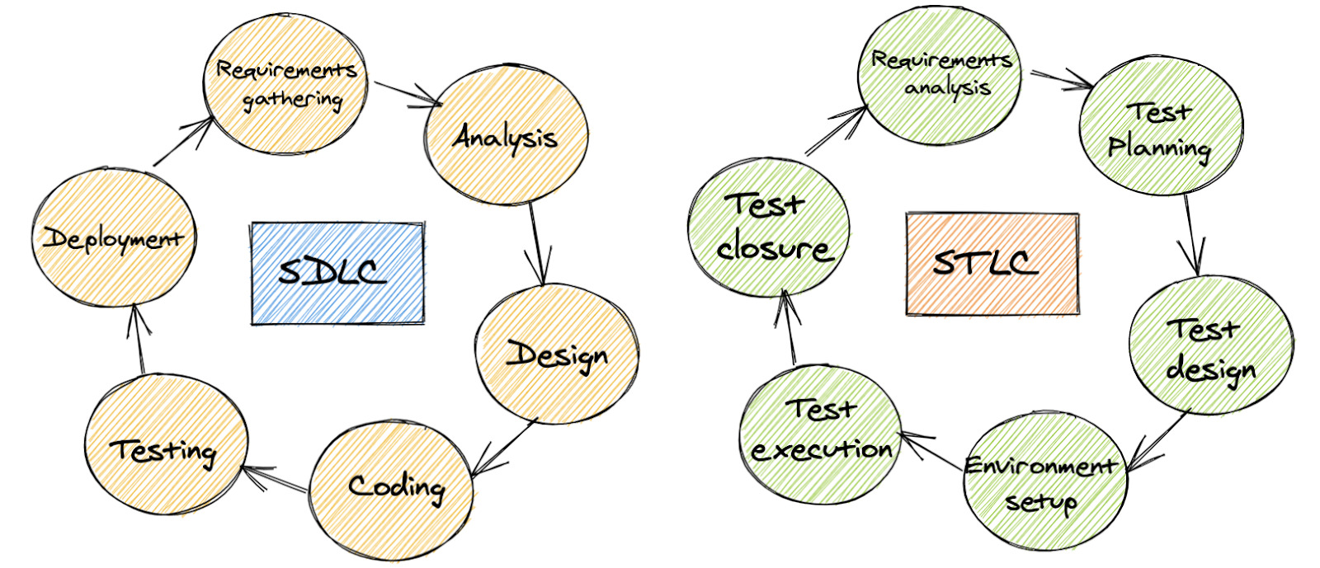
SDLC vs STLC

Slide 6
Test Stage

Slide 7
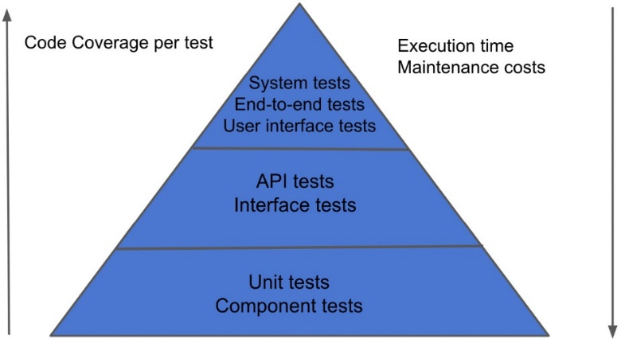
Test Stage

Slide 8
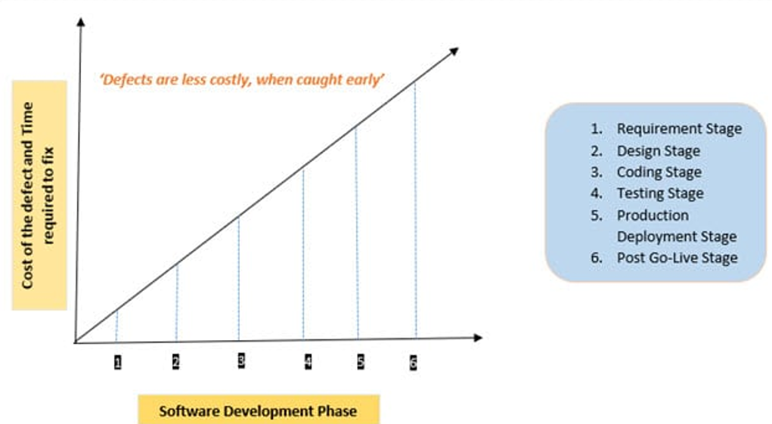

Slide 9
Shift-Left Approach

Slide 10
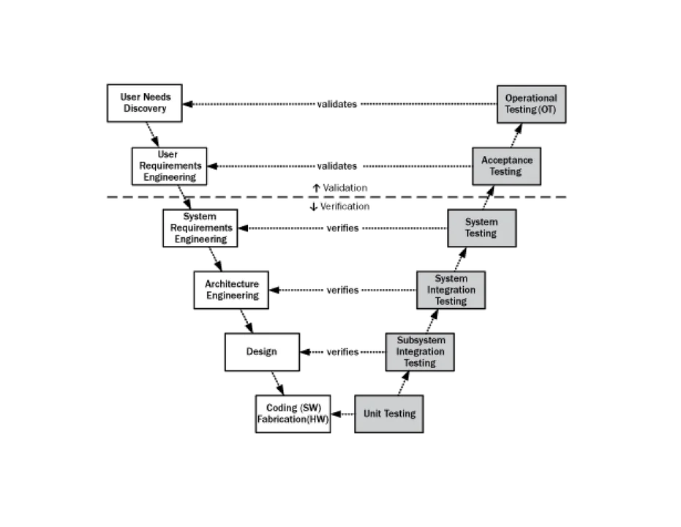
Shift-left Approach

Slide 11
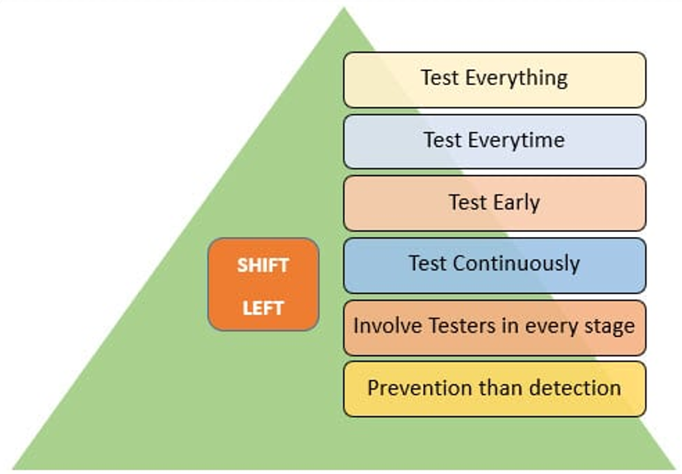

Slide 12
Reference
https://blog.testproject.io/2020/11/03/software-testing-life-cycle-stlc/
https://www.lambdatest.com/blog/software-testing-life-cycle/

Slide 13
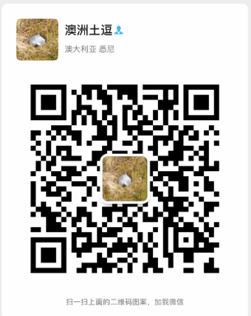
Contact
Your success is our success
Mail: info@funnygorilla.com.au
Linkedin: https://mt.linkedin.com/in/songqing-gu-2ba9034b/de
Web Chat: FunnyGorilla
Phone: 0420891343

